Slide 1
The Elusive 13 Piece Complete Set Puzzle
Designing a puzzle for G4G13
By Peter Knoppers

Slide 2
A Puzzle for G4G13
Should be related to Martin Gardner and/or 13
I’ll leave the martingardner 13 letter based puzzles to others
I want a puzzle with shaped pieces that naturally exhibits the number 13
Thirteen is an uncommon number …

Slide 3
The Shape Enumerator
A long time ago I wrote a PERL program that enumerates the number of possible regular polygons with N edges, K edge styles with or without flipping
Flipping requires specifying a translation that describes wether a flipped edge looks like itself, or like another edge. e.g. 01 ⇒ 01, or 01 ⇒ 10, or 012 ⇒ 021

Slide 4

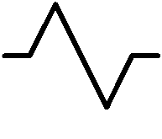

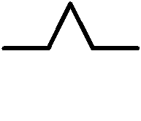
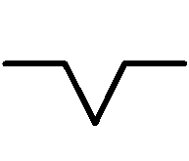
Edge Flipping rules
Straight edge stays straight ⇒ (0 ⇒ 0)
Rotational symmetrical edge inverses ⇒
Mirror symmetrical edge stays the same ⇒
(1 ⇒ 2)
(12 ⇒ 21)
(34 ⇒ 34)
(3 ⇒ 3)

Slide 5


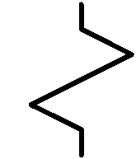
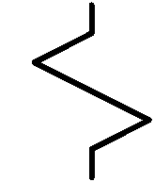
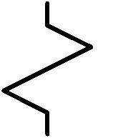
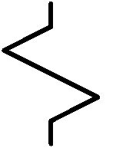
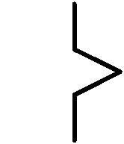
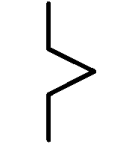
Edge Matching Rules
Straight edge always matches a straight edge
Rotational symmetric edge matches itself, except when the piece is flipped
Mirror symmetric edge does not match itself, but it will match the inverted shape

Slide 6
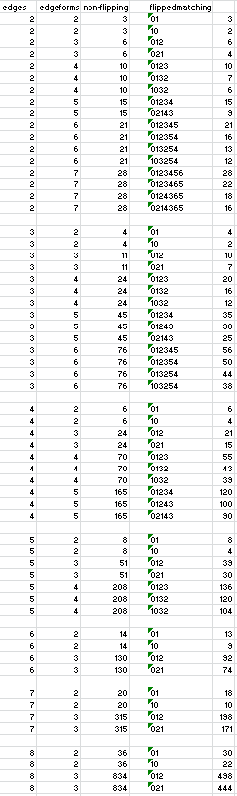
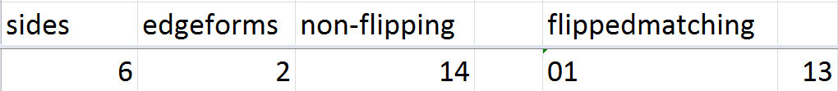
Search
I tested all regular polygons from 2 up to 8 sides
Using up to 7 edge types
With and without flipping
The number 13 appears exactly once

Slide 7

Results
I found precisely one reasonable family of shapes that has 13 members
Hexagonal pieces with two edge types, Flipping translates 01 ⇒ 01
000000 000001 000011 000101
000111 001001 001011 001111
010101 010111 011011 011111
111111

Slide 8


Making a Puzzle from the Set
Interlocking edges make a nicer puzzle
⇒
Most “somewhat” convex shapes using 13 hexes have thousands or millions of solutions
Specifying the entire outline can reduce that number considerably

Slide 9

13-Piece Complete Set Puzzle
This shape has only 5 solutions
Beware …
There is a “catch”
I won’t tell you what the catch is

Slide 10
13-Piece Complete Set Puzzle
The set can also be used to play domino-like games
You’ll have to work out the rules for those domino-like games yourself
You’ll find a physical set of the pieces and some puzzle outlines in your goody bag
The Shape Enumerator can be downloaded from http://buttonius.com/g4g13

